Slide 1

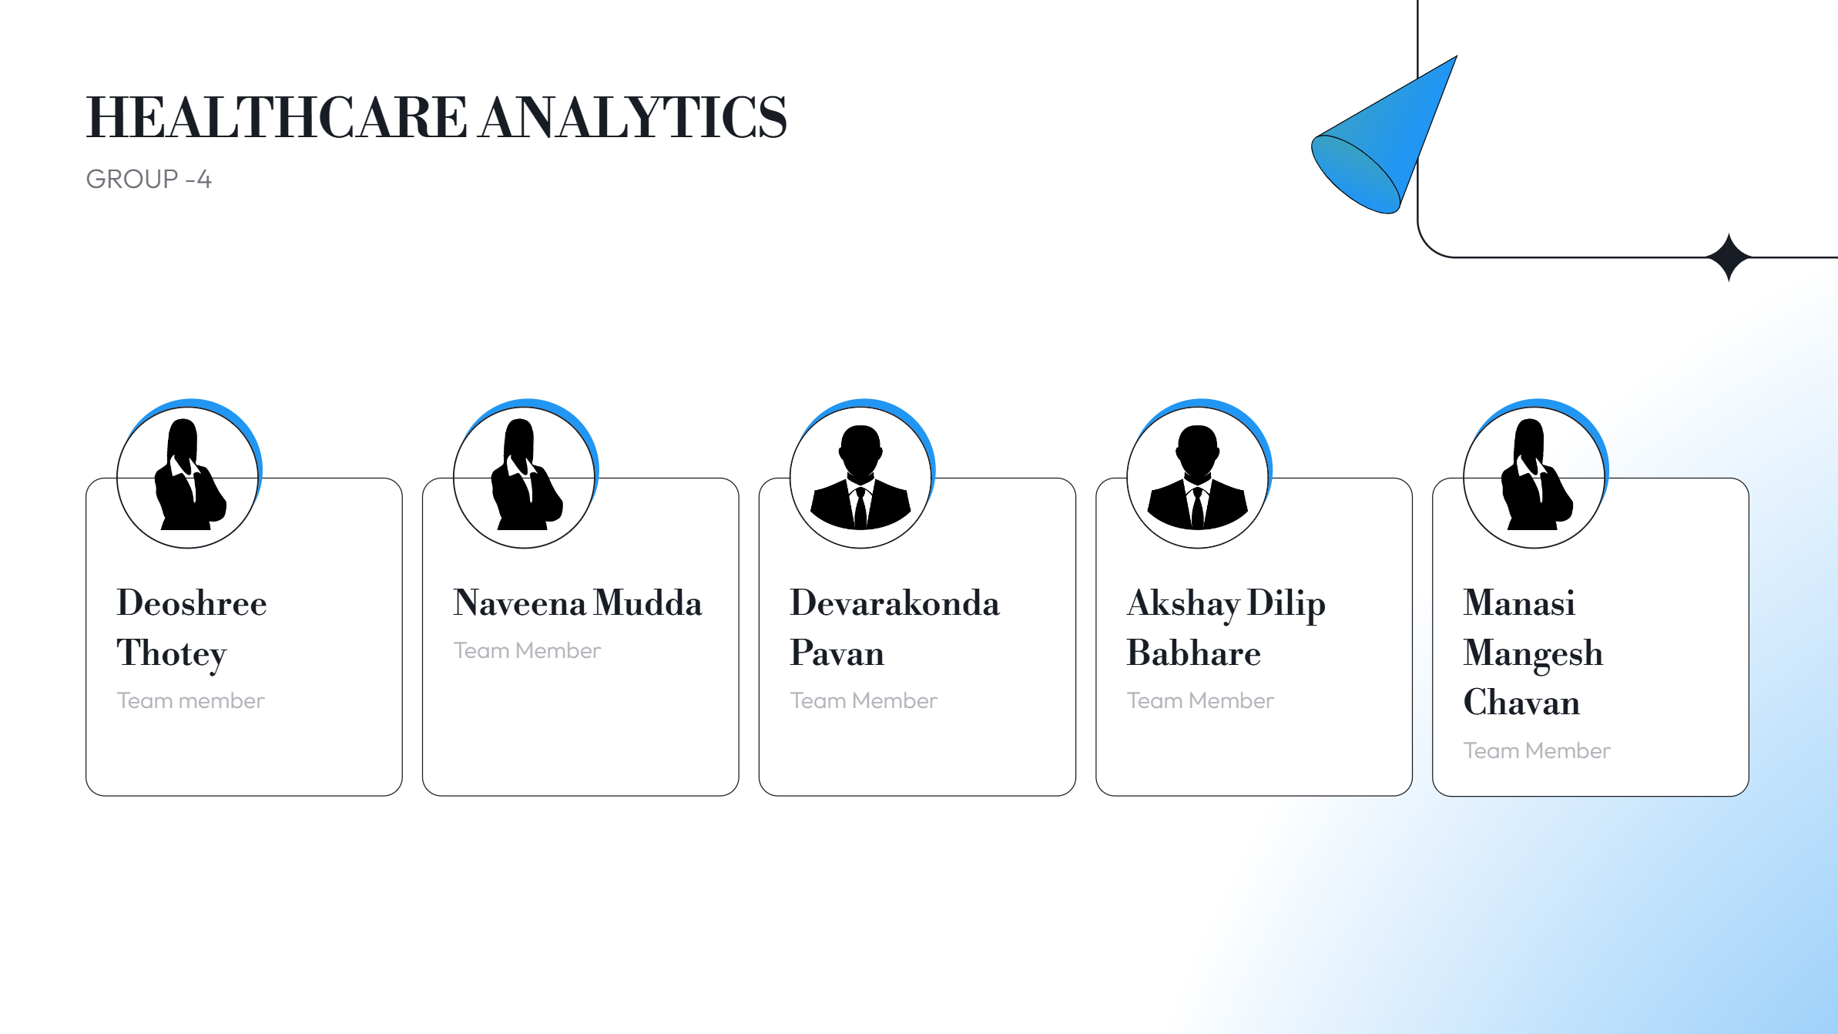

HEALTHCARE ANALYTICS
GROUP -4
Deoshree Thotey
Naveena Mudda
Santhoshi Thakur
Devarakonda Pavan
Akshay Dilip Babhare
Manasi Mangesh Chavan
Samala Sai Varun

Slide 2
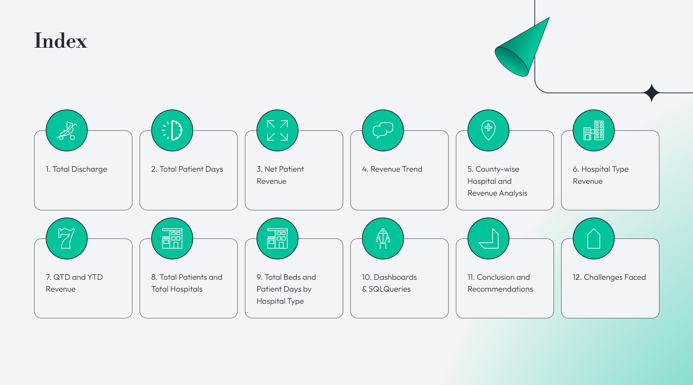
Index
1. Total Discharge
2. Total patient Days
3. Net Patient Revenue
4. Revenue Trend
5. County-wise Hospital and Revenue Analysis
6. Hospital Type Revenue
7. QTD and YTD Revenue
8 Total patients and Total Hospitals
9. Total Beds and Patient Days by Hospital Type
10. Conclusion and Recommendations
11. Challenges Faced

Slide 3
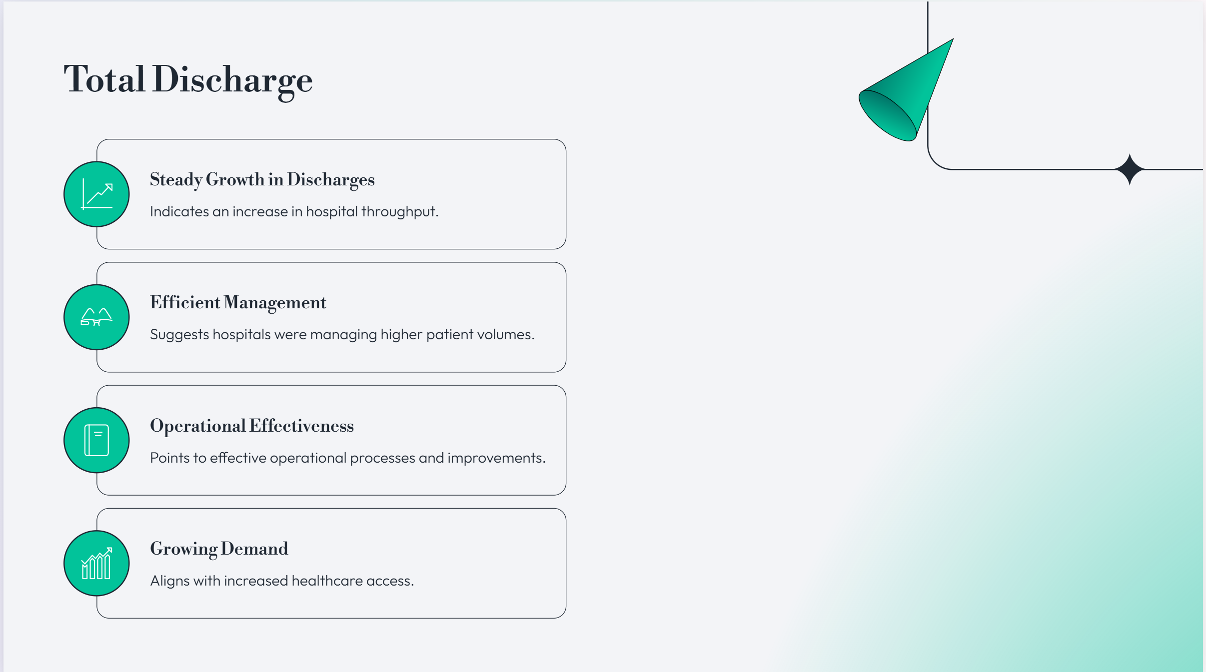
1) Total Discharge
Steady growth in total discharges from 2017 to 2019, indicating an increase in hospital throughput.
The consistent rise suggests that hospitals were efficiently managing higher patient volumes.
This trend points to effective operational processes and potential improvements in patient care or hospital infrastructure.
The increase aligns with growing demand or improved healthcare access.

Slide 4
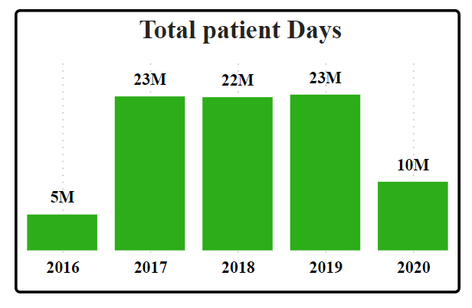
2) Total Patient Days
A stable number of total patient days from 2017 to 2019 reflects efficient patient flow and management within hospitals.
The consistency in patient days highlights strong resource utilization, including beds and staffing.
There were no significant fluctuations in patient turnover during this period, suggesting balanced admissions and discharge rates.
This stability indicates hospitals were operating at optimal capacity without overburdening resources.

Slide 5
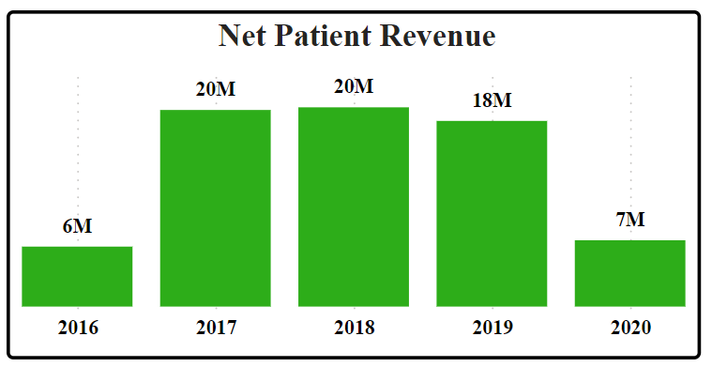
3) Net Patient Revenue
Net patient revenue remained consistently high from 2017 to 2019, reflecting robust billing and reimbursement systems.
The slight dip observed in 2019 did not significantly impact overall financial stability.
Revenue trends mirrored patient days, indicating a direct link between patient services and hospital income.
Financial performance remained strong, showcasing efficient revenue management practices.

Slide 6
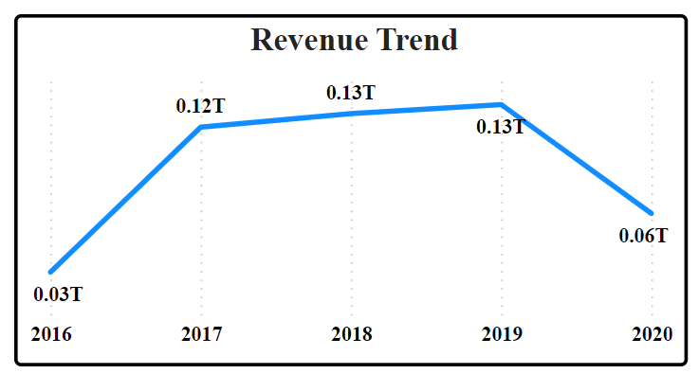
4) Revenue Trend
Revenue showed a significant upward trend from 2016 to 2019, peaking in 2019 at $0.13 T.
The highest revenue growth occurred between 2017 and 2018, reflecting enhanced hospital efficiency and increased patient throughput.
This upward trend indicates sustained financial growth driven by improvements in operational efficiency.
The increase in revenue suggests successful strategies in patient management and service delivery.

Slide 7
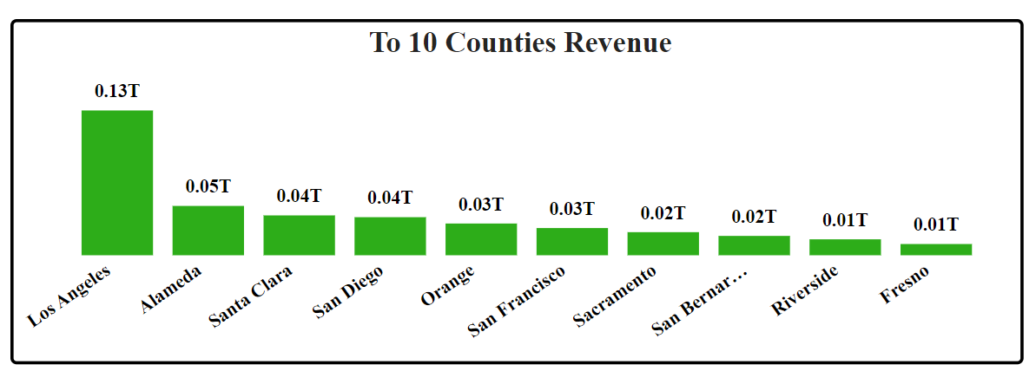
5) County Wise No. of Hospitals/Revenue
Los Angeles County was the highest revenue generator, with over $133.47B, leading significantly compared to other counties.
Other major counties, like Orange and San Bernardino, also contributed substantial revenue, but at much lower rates than Los Angeles.
Disparities in revenue generation exist between counties, with smaller regions like San Francisco and Fresno contributing less.
Despite lower revenues, all counties provide essential healthcare services and remain crucial to the overall healthcare system.

Slide 8
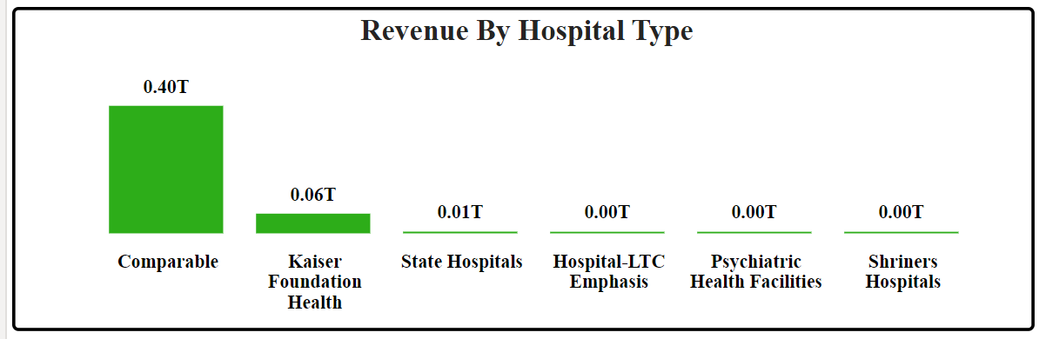
6) Type of Hospital Revenue
Comparable hospitals accounted for the largest share of revenue, dominating the healthcare landscape.
Kaiser Foundation and State Hospitals contributed significantly but still lagged behind comparable hospitals.
Specialized facilities, such as Psychiatric Health Facilities and Shriners Hospitals, generated minimal revenue, indicating underutilization.
Revenue concentration within certain hospital types suggests a need for optimization in specialized and underperforming hospitals.

Slide 9
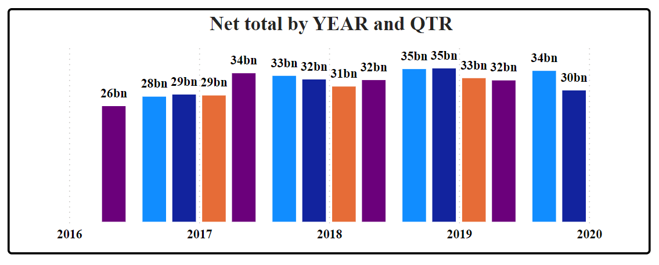
7) QTD and YTD Revenue
A steady increase in QTD and YTD revenue was observed from 2016 to 2019, reflecting consistent financial growth across all four quarters.
2019 marked the highest QTD revenue, showing strong financial performance throughout the year.
The consistent quarterly growth pattern from 2016 to 2019 indicates effective financial management across the years.
This sustained revenue growth demonstrates operational stability and effective service delivery.

Slide 10
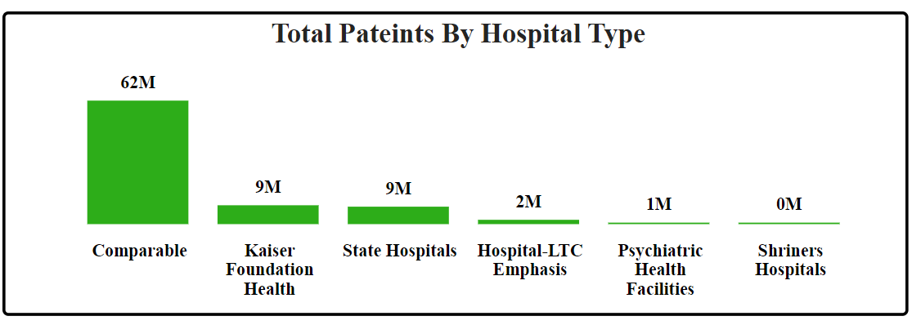
8) Total Patient and Total Hospitals
The total number of hospitals remained stable at 457 from 2017 to 2020, indicating no major changes in healthcare infrastructure during this period.
The total number of patients served increased from 2017 to 2019, showing that the healthcare system was running at full capacity.
The stability in infrastructure reflects resilience, with hospitals maintaining consistent operations.
The system’s ability to serve more patients from 2017 to 2019 points to strong operational efficiency.

Slide 11
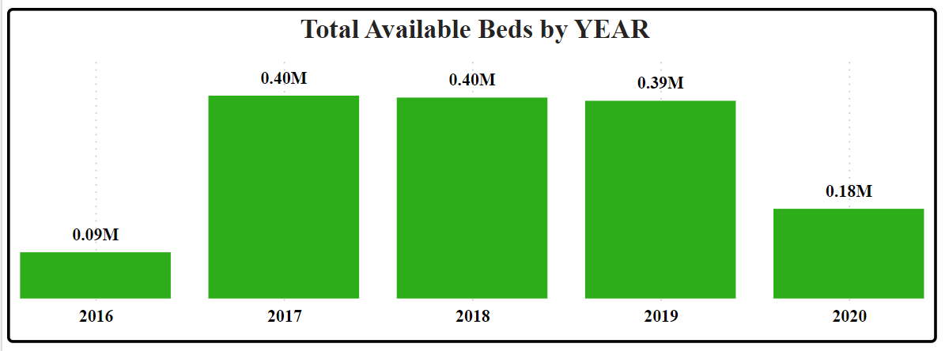
9) Total Available Beds by Year
The number of available beds remained stable from 2017 to 2019, suggesting that the healthcare system had adequate capacity during this period.
Kaiser Foundation hospitals reported the highest number of patient days, followed by State Hospitals, indicating their critical role in patient care.
Specialized facilities like Shriners Hospitals and Psychiatric Health Facilities showed significantly fewer patient days, highlighting underutilization.
The consistency in bed availability suggests hospitals were well-prepared to meet patient demands.

Slide 12
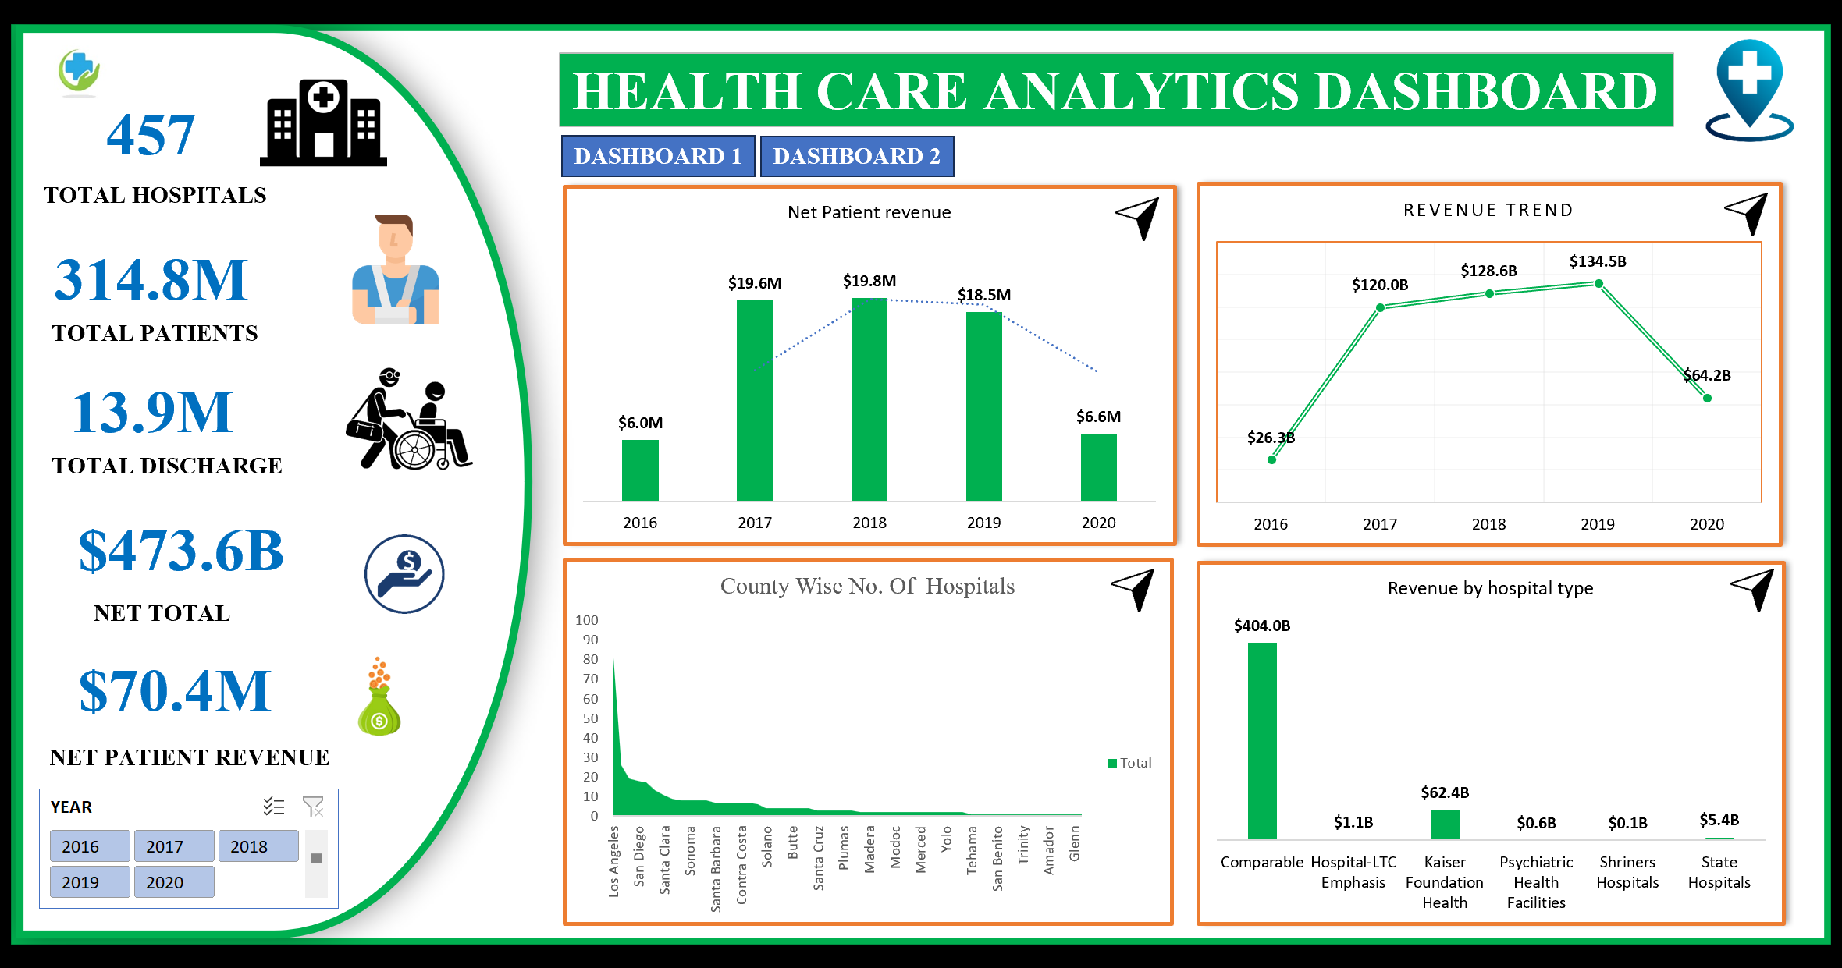

Slide 13
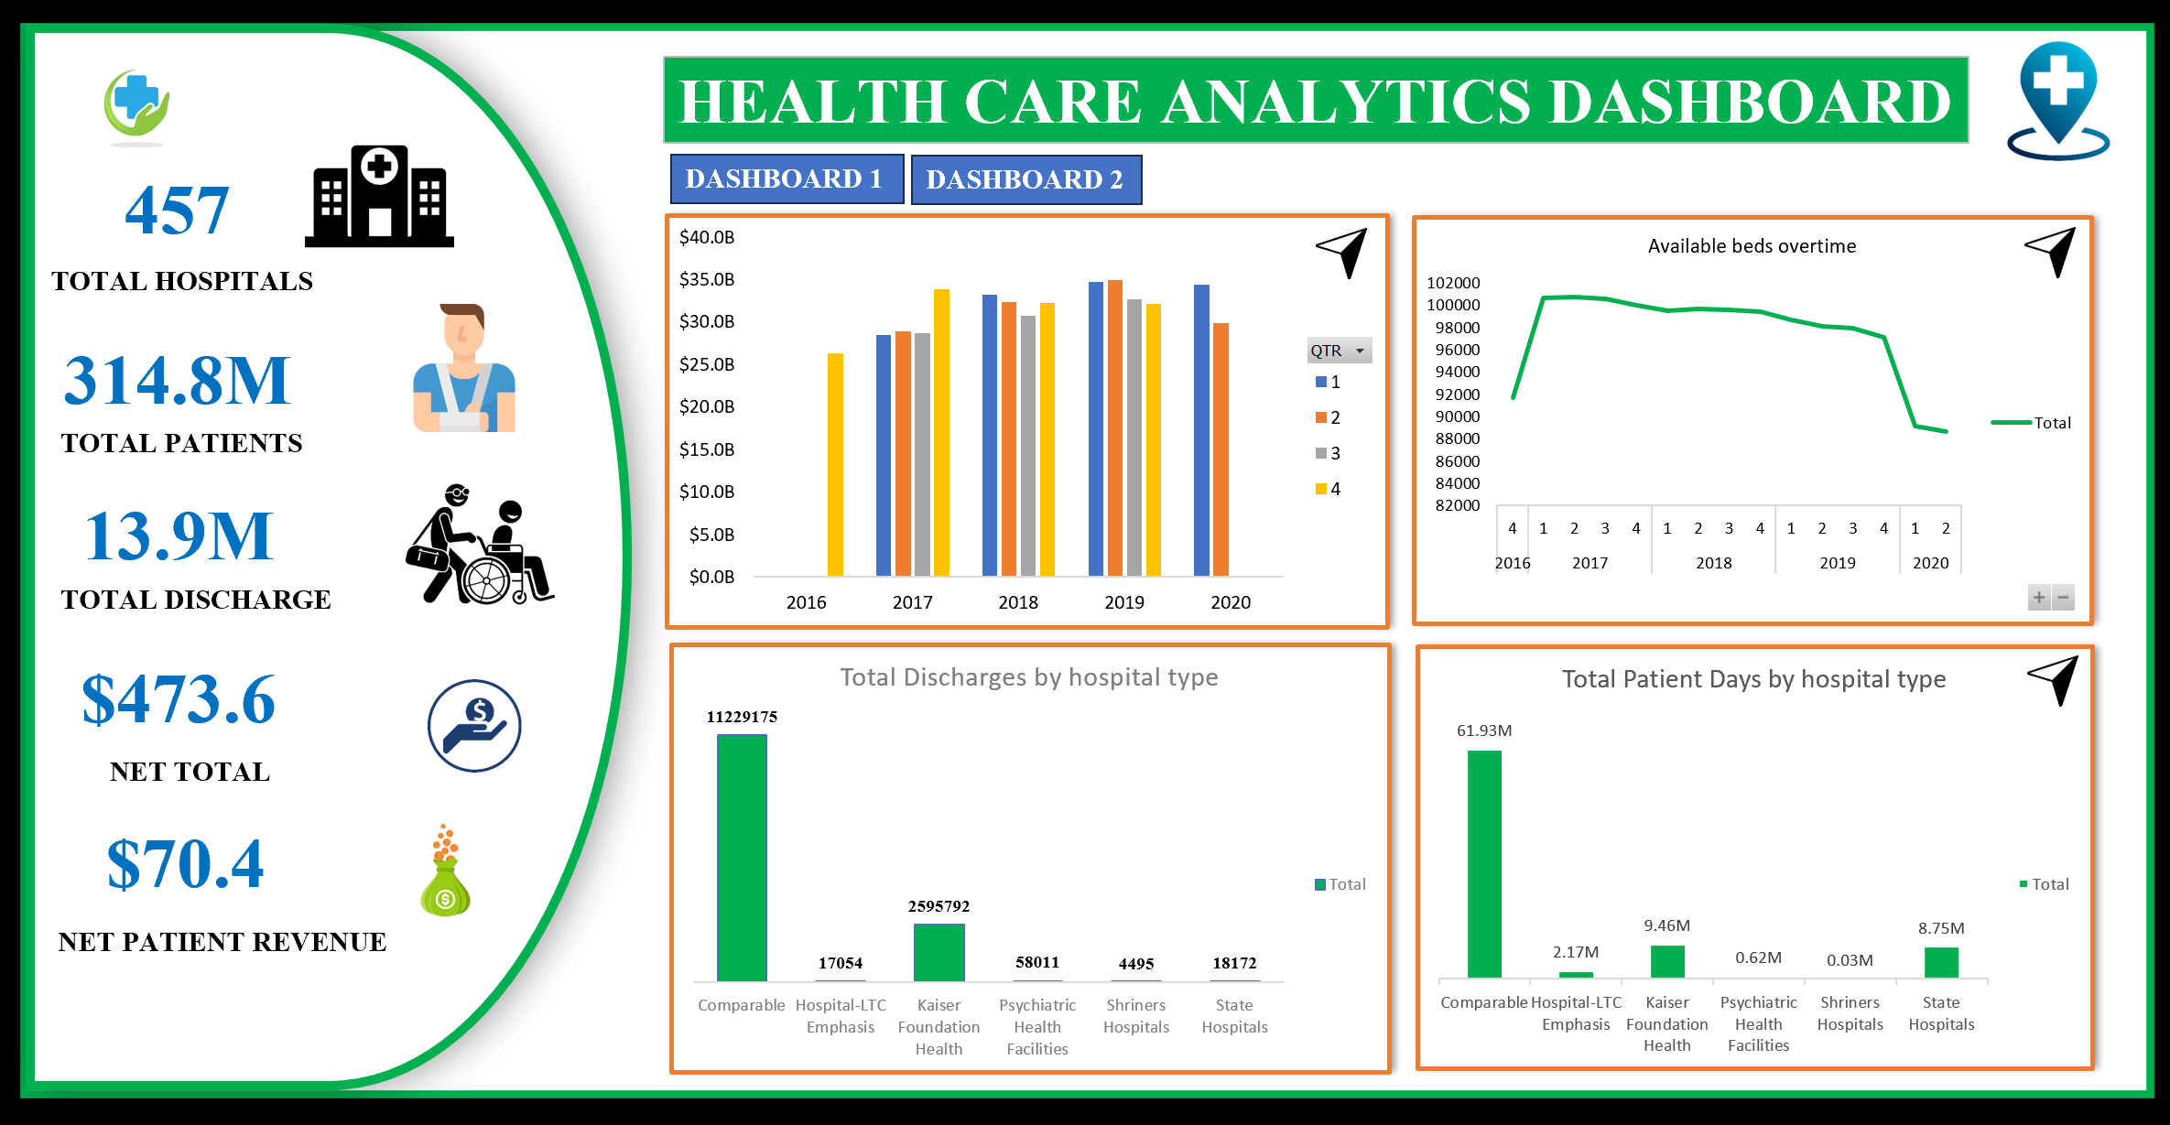

Slide 14
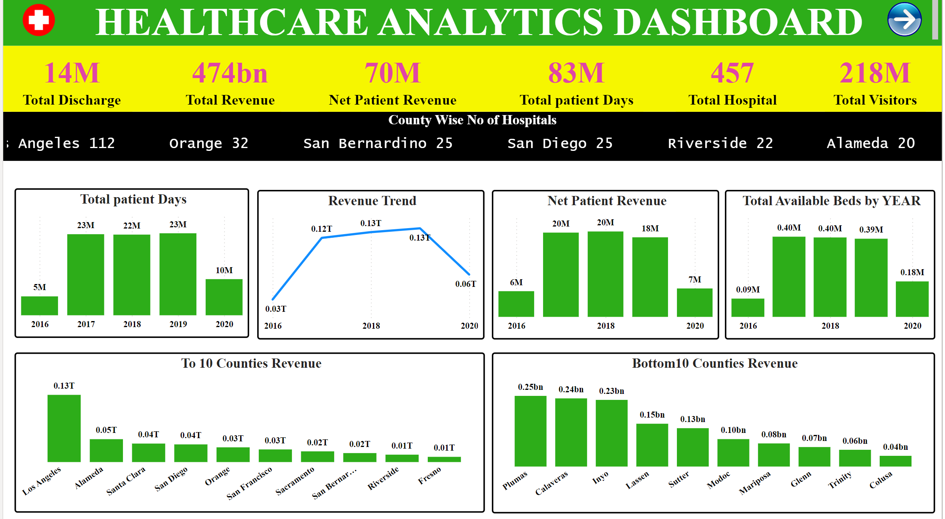

Slide 15
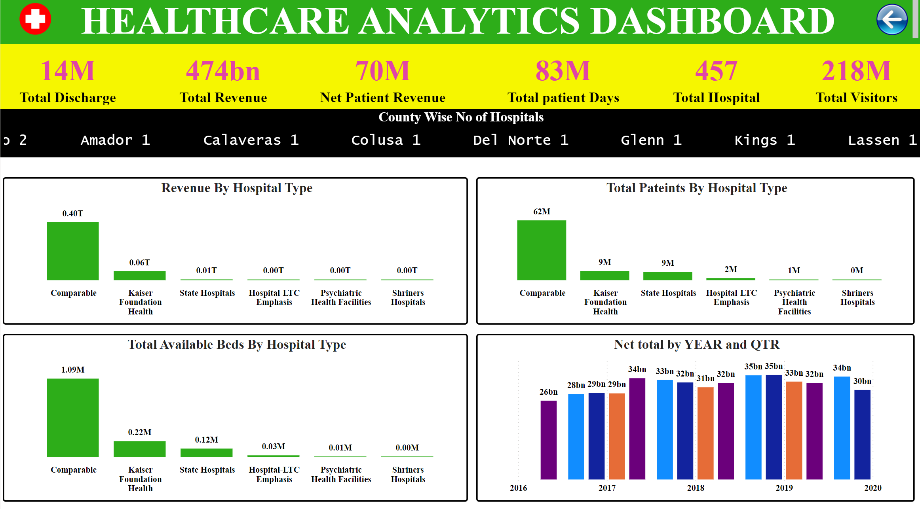

Slide 16
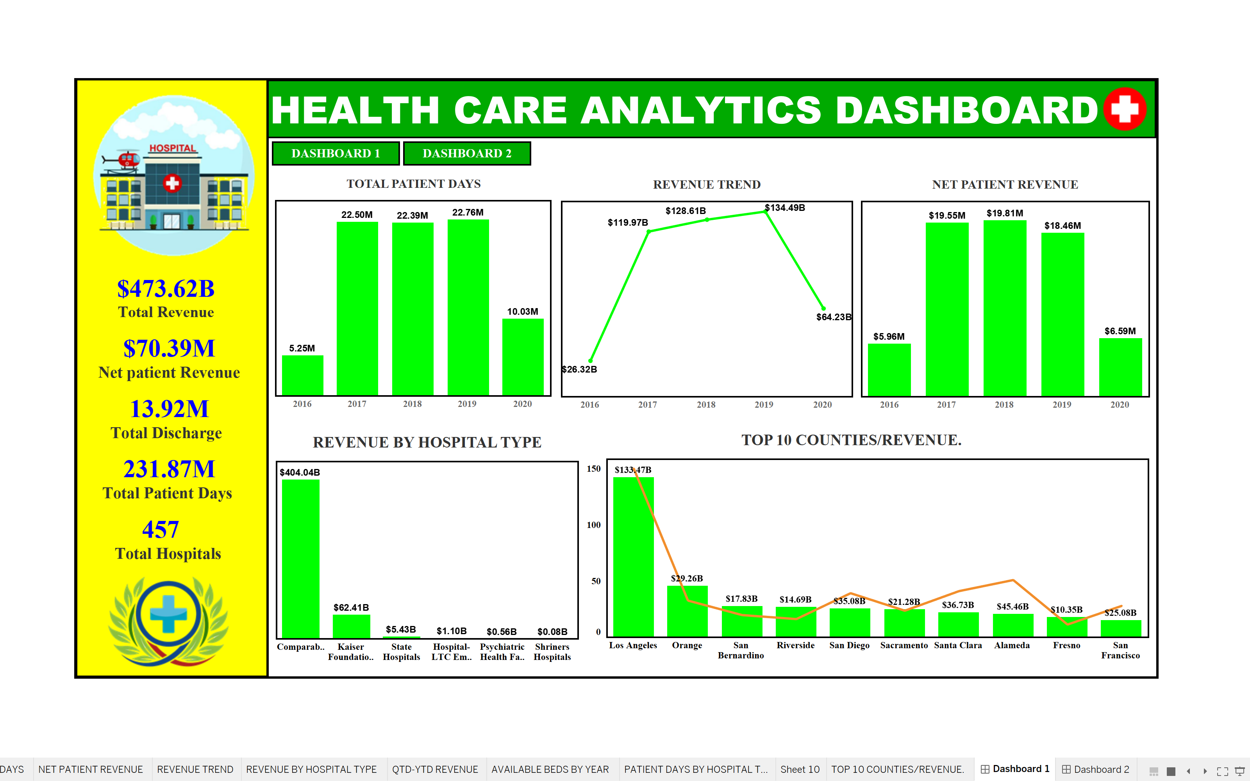

Slide 17
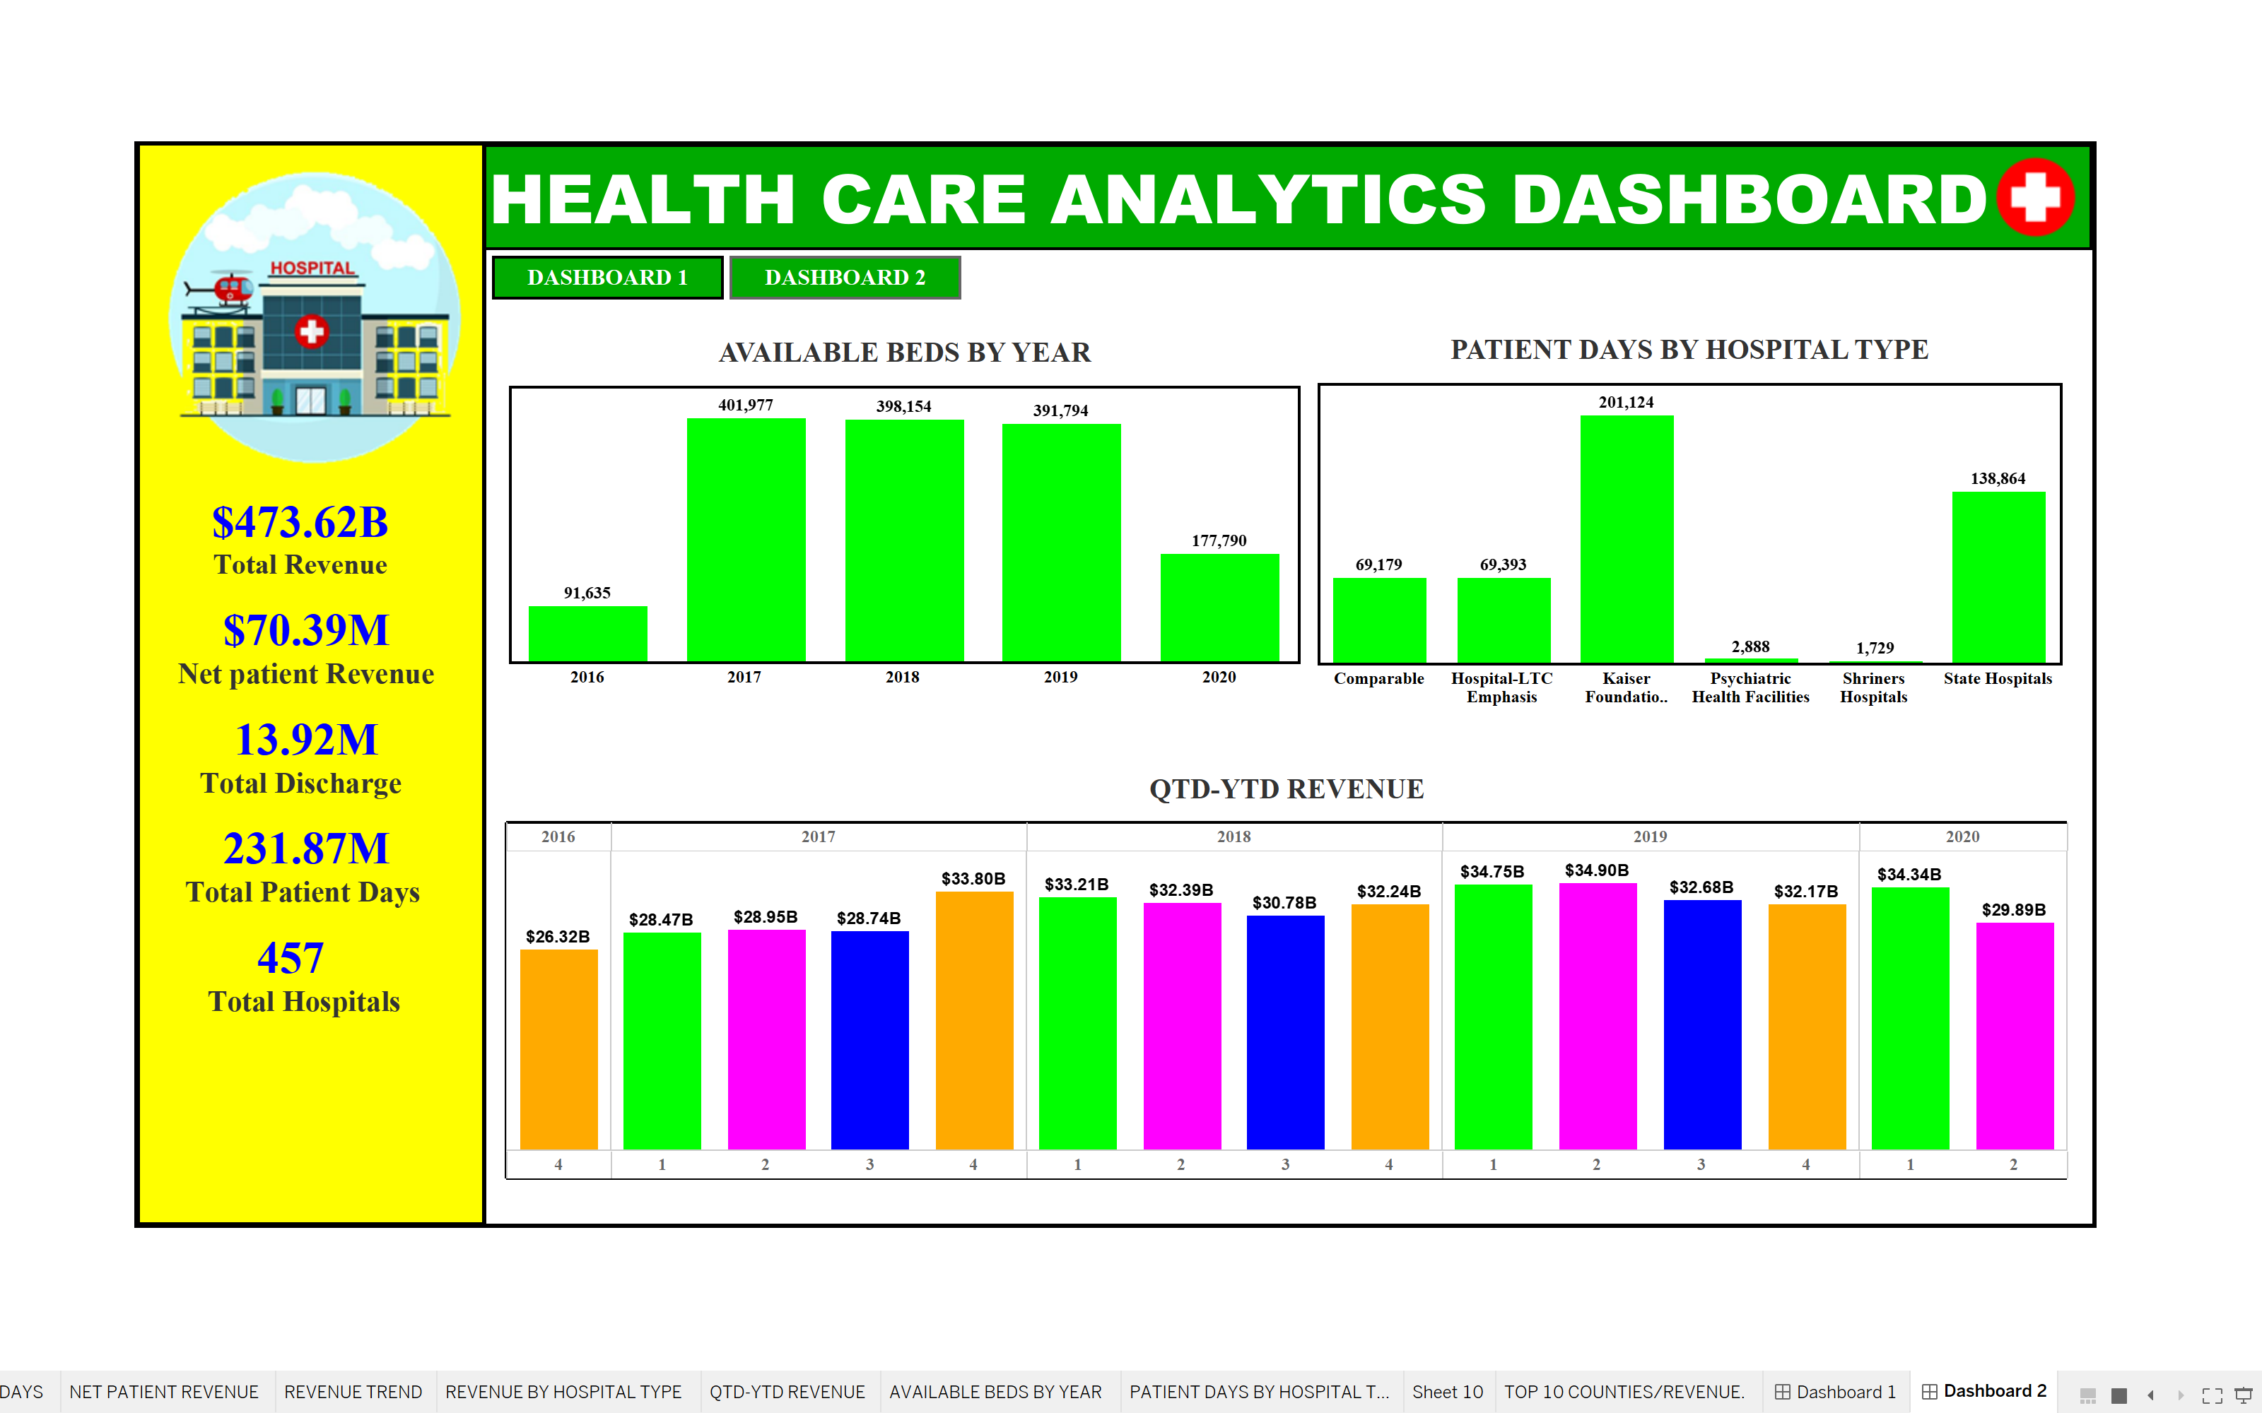

Slide 18
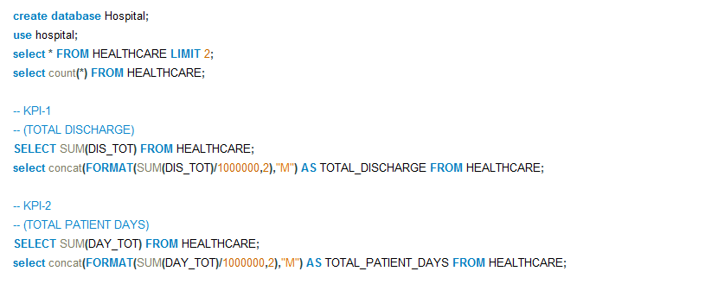
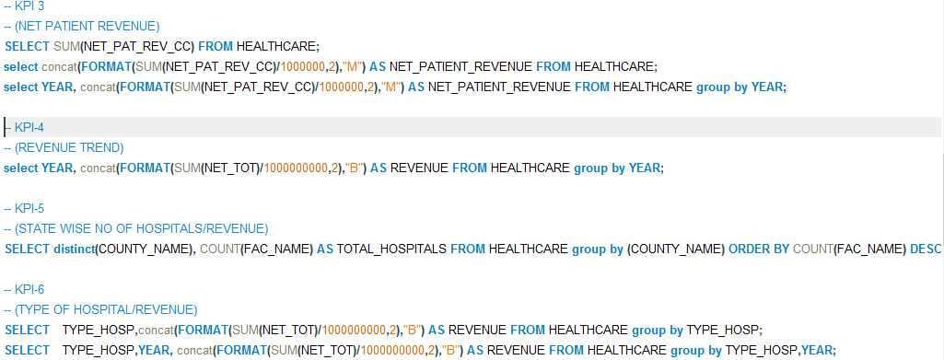

Slide 19
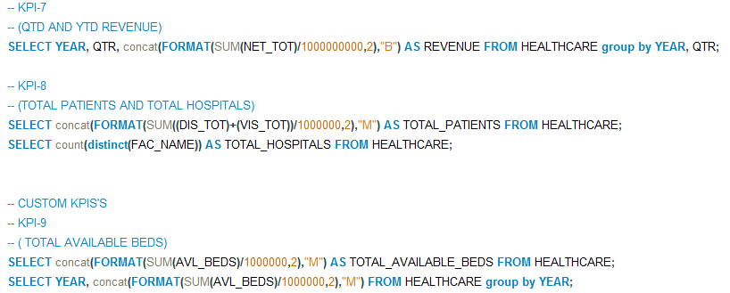

Slide 20
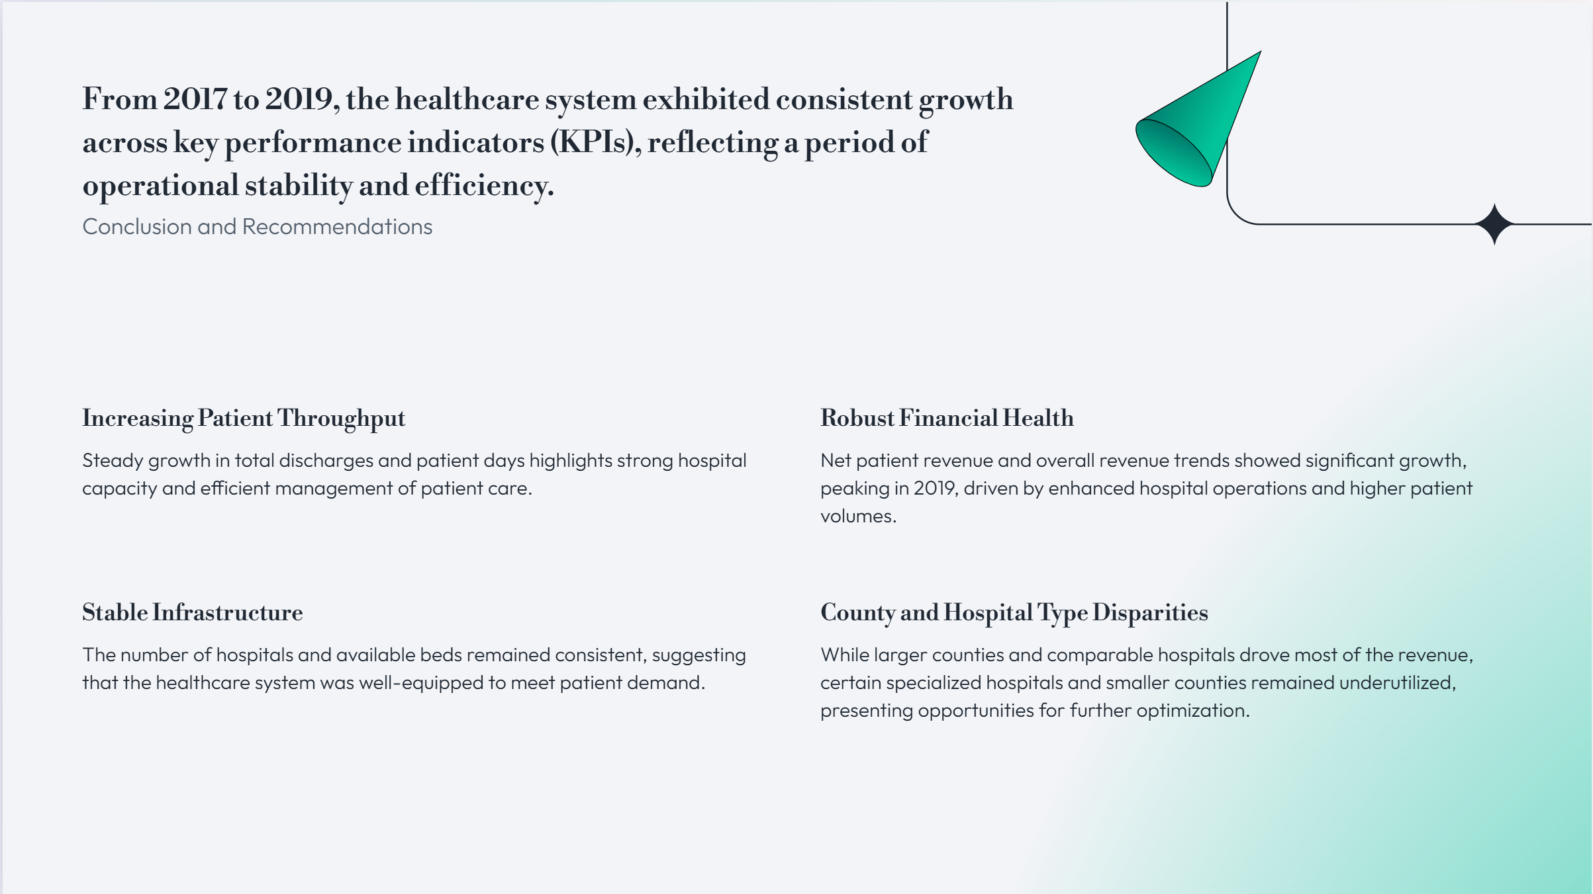
Conclusion and Recommendations
From 2017 to 2019, the healthcare system exhibited consistent growth across key performance indicators (KPIs), reflecting a period of operational stability and efficiency. The data shows:
Increasing Patient Throughput: Steady growth in total discharges and patient days highlights strong hospital capacity and efficient management of patient care.
Robust Financial Health: Net patient revenue and overall revenue trends showed significant growth, peaking in 2019, driven by enhanced hospital operations and higher patient volumes.
Stable Infrastructure: The number of hospitals and available beds remained consistent, suggesting that the healthcare system was well-equipped to meet patient demand.
County and Hospital Type Disparities: While larger counties and comparable hospitals drove most of the revenue, certain specialized hospitals and smaller counties remained underutilized, presenting opportunities for further optimization.

Slide 21
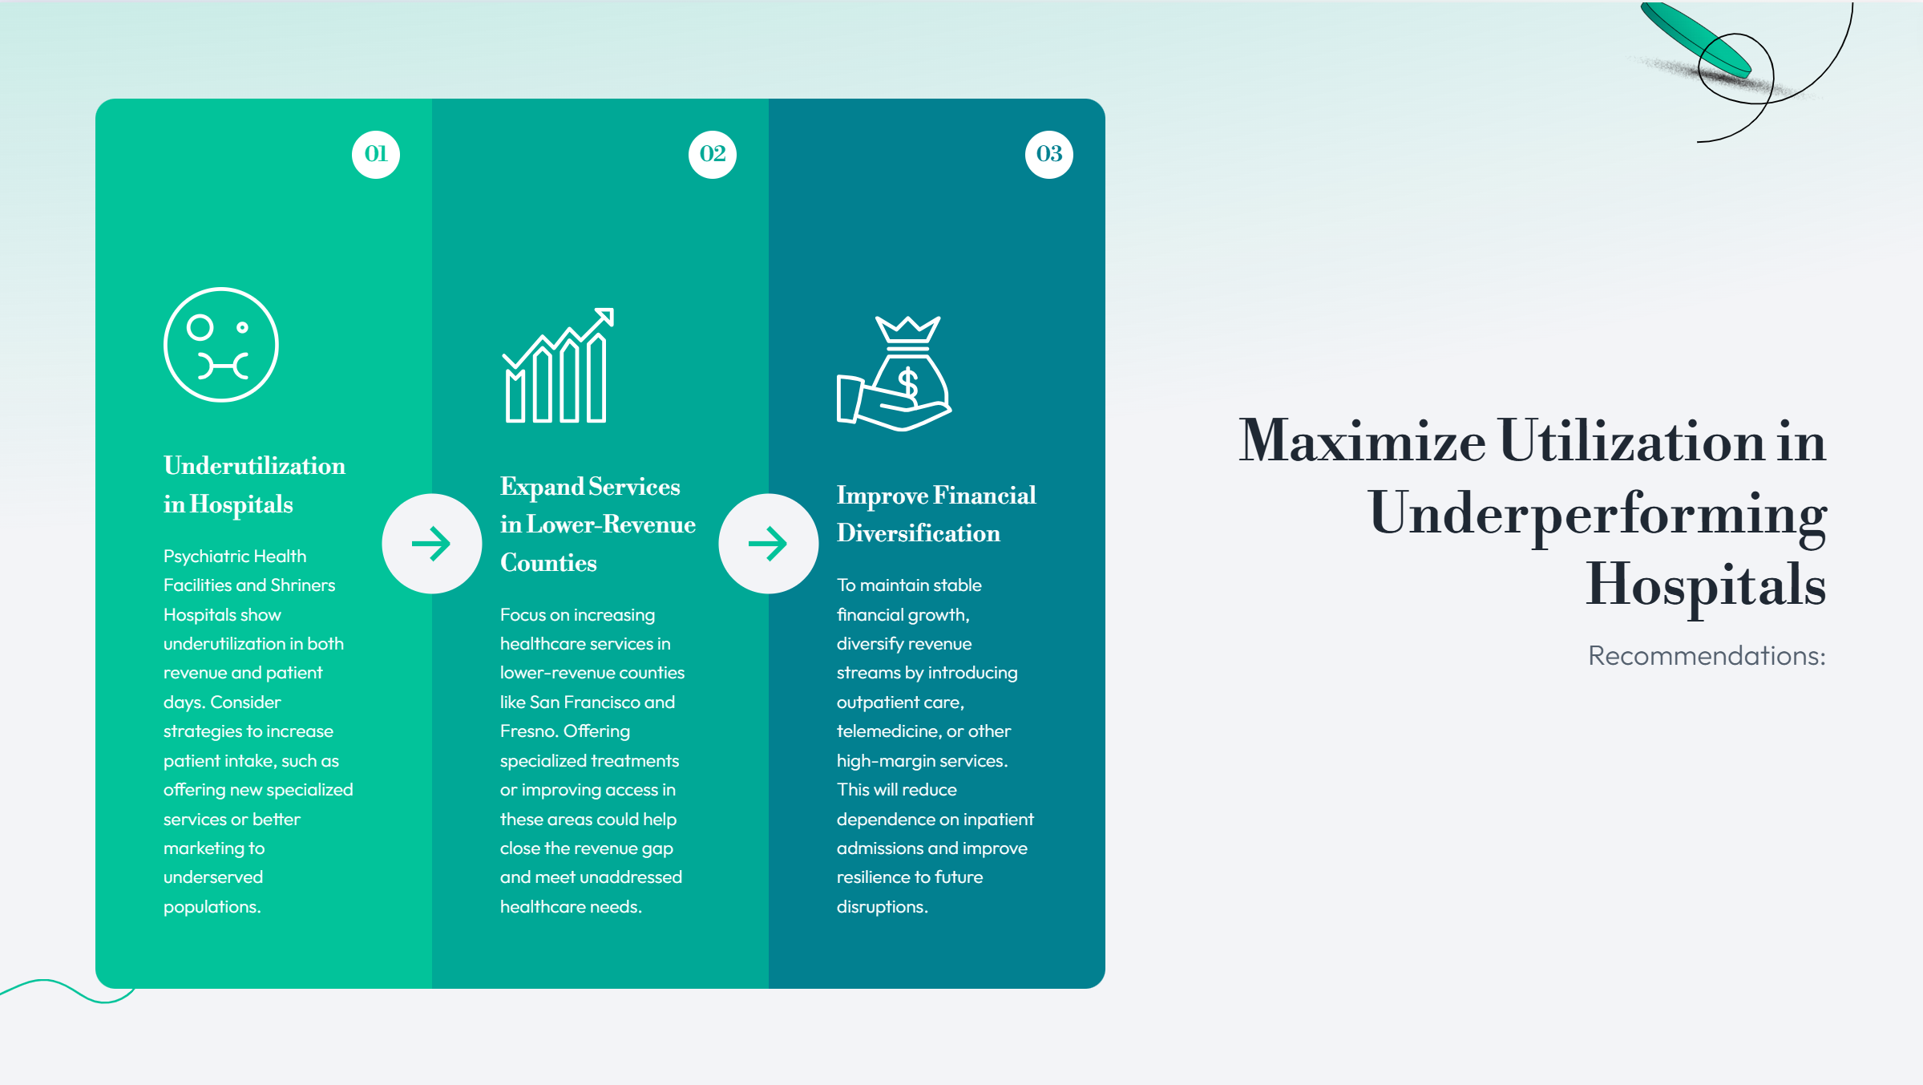
Recommendations:
1. Maximize Utilization in Underperforming Hospitals:
Psychiatric Health Facilities and Shriners Hospitals show underutilization in both revenue and patient days. Consider strategies to increase patient intake, such as offering new specialized services or better marketing to underserved populations.
2. Expand Services in Lower-Revenue Counties:
Focus on increasing healthcare services in lower-revenue counties like San Francisco and Fresno. Offering specialized treatments or improving access in these areas could help close the revenue gap and meet unaddressed healthcare needs.
3. Improve Financial Diversification:
To maintain stable financial growth, diversify revenue streams by introducing outpatient care, telemedicine, or other high-margin services. This will reduce dependence on inpatient admissions and improve resilience to future disruptions.

Slide 22
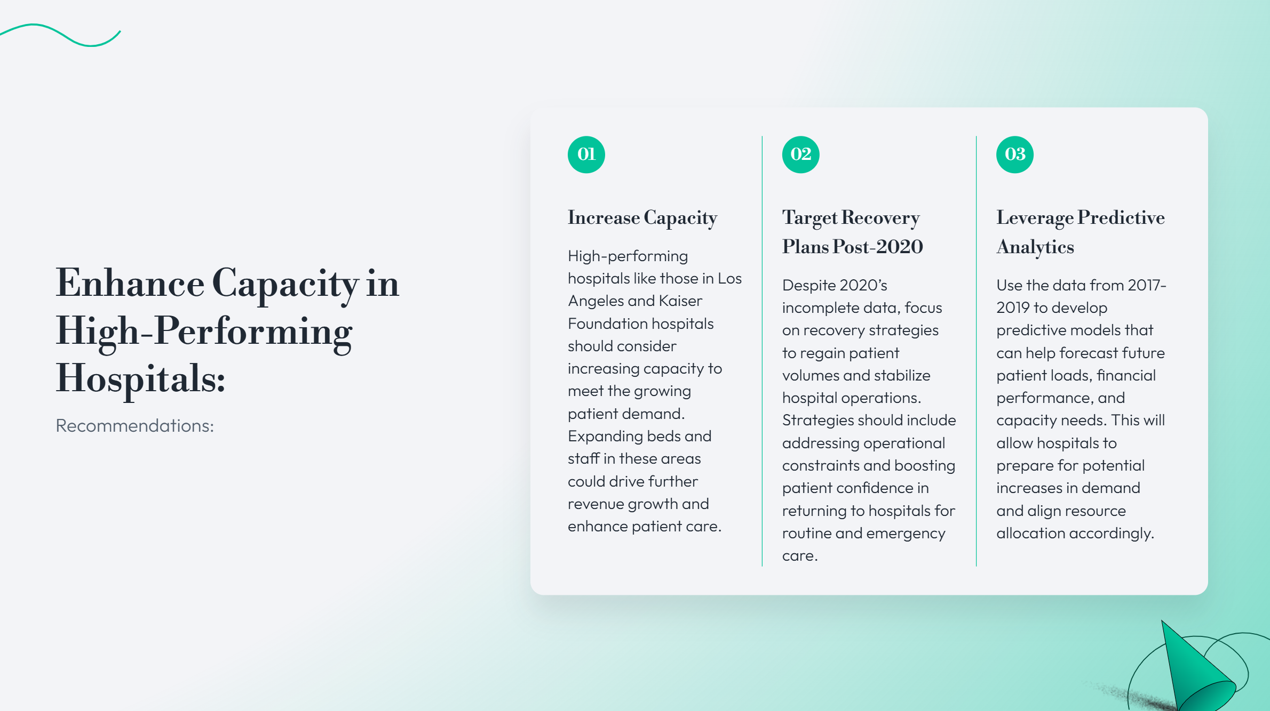
Recommendations:
4. Enhance Capacity in High-Performing Hospitals:
High-performing hospitals like those in Los Angeles and Kaiser Foundation hospitals should consider increasing capacity to meet the growing patient demand. Expanding beds and staff in these areas could drive further revenue growth and enhance patient care.
5. Target Recovery Plans Post-2020:
Despite 2020’s incomplete data, focus on recovery strategies to regain patient volumes and stabilize hospital operations. Strategies should include addressing operational constraints and boosting patient confidence in returning to hospitals for routine and emergency care.
6. Leverage Predictive Analytics for Future Planning:
Use the data from 2017-2019 to develop predictive models that can help forecast future patient loads, financial performance, and capacity needs. This will allow hospitals to prepare for potential increases in demand and align resource allocation accordingly.

Slide 23
Challenges Faced in Data Transformation
Missing County Data
Challenge: Several records were missing values in the COUNTY_NAME column, impacting the geographical analysis.
Solution: Used Excel's VLOOKUP function to populate missing county names by referencing other data tables.
Date Format Issues
Challenge: Inconsistent date formats in the BEG_DATE and END_DATE columns (e.g., different formats like 10/1/2016 and 31-12-2016).
Solution: Standardized date formats in Excel Power Query to ensure consistency across all records for time-series analysis.
Year and Quarter in a Single Column
Challenge: The YEAR_QTR column combined both year and quarter (e.g., 20164), making it difficult to analyze trends by quarter.
Solution: Split the YEAR_QTR column into two separate columns, one for YEAR and one for QUARTER, using Power Query transformation functions.
Unwanted Columns
Challenge: The dataset included unnecessary columns like ADDRESS, PHONE_NUMBER, and other irrelevant details, which cluttered the analysis.
Solution: Deleted unwanted columns to focus on key metrics such as patient revenue, hospital status, and geographic data.

Slide 24


